Slide 1

FHIR Webinar
Grahame Grieve
4-Dec 2012

Slide 2
FHIR
Fast Health Interoperability Resources
Pronounced “Fire”
…insert your fire related joke here….

Slide 3
Why FHIR?
Arose out of Fresh Look Taskforce: “What would interoperability look like if we started afresh”
Existing standards are not a platform for the future:
V2 – venerable, but old technology, self limiting
V3 – thorough and correct, but not practical
CDA – well established, but also limited in scope and difficult
Different approaches not reconciled

Slide 4
Why FHIR?
Web search for success markers led to RESTful based APIs
Exemplar: Highrise (https://github.com/37signals/highrise-api)
Drafted a healthcare Exchange API based on this approach
This has grown into FHIR

Slide 5
Target Markets
Classic in-institution interoperability
Back-end e-business systems (financial)
RHIO
National EHR systems
Social Web (Health)
Mobile Applications

Slide 6
Resources
“Resources” are:
Small logically discrete units of exchange
Defined behaviour and meaning
Known identity / location
Smallest unit of transaction
Represented in XML or JSON (or others)
Addressed through HTTP or other methods

Slide 7
Resources
Administrative Concepts
Person, Patient, Organization, Device, Facility
Coverage, Invoice, etc.
Clinical Concepts
Allergy, Problem, Medication, Family History
Care Plan
Infrastructure Functionality
Document, Message, Conformance/Profiling

Slide 8
Resources
Resources have 3 parts
Defined Structured Data
The logical, common contents of the resource
Mapped to formal definitions/RIM & other formats
Extensions
Local requirements, but everyone can use
Published and managed
Narrative
Human readable (fall back)

Slide 9
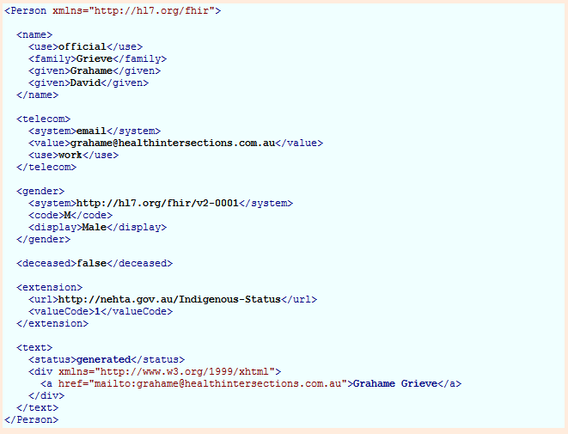
Person

Slide 10
Resources
Resources have 3 parts
Defined Structured Data
The logical, common contents of the resource
Mapped to formal definitions/RIM & other formats
Extensions
Local requirements, but everyone can use
Published and managed
Narrative
Human readable (fall back)

Slide 11
Using Resources
Classic HTTP RESTful approach
Simple approach led by Facebook, Twitter, etc.
Atom (RSS feed standard)
Use Atom to “bundle” resources
Pub/sub framework, Multi-resource Transactions
Messages (v2-like), Documents (per CDA)
Custom Services / SOA
Same content
Same base rules

Slide 12
The Specification
Introduction
Background, basics, framework
Implementation
HTTP, conformance, JSON, etc.
Resource Definitions
Actual logical definitions of resources and their behaviour

Slide 13
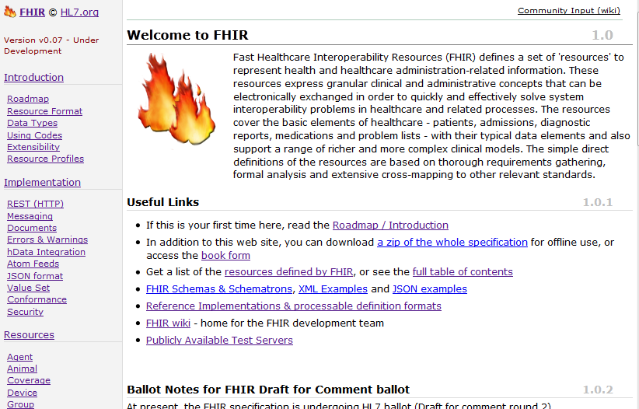

Slide 14
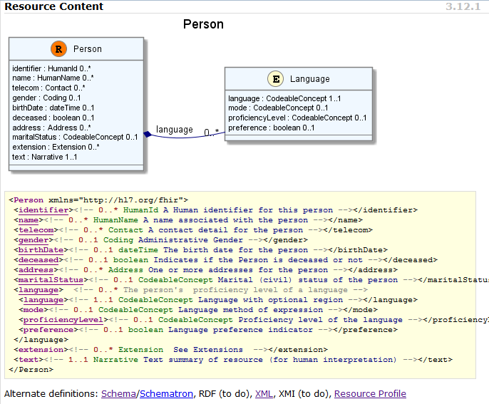

Slide 15
Ethos
Simplicity / Web alignment
Implementation focused
Reference Implementations published
Publically available test servers (now)
Connectathon
Freely available
http://hl7.org/fhir
Unencumbered – free for anyone to use

Slide 16
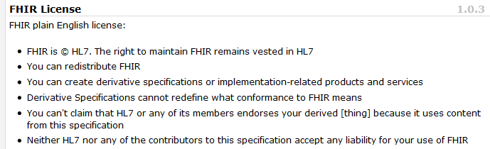
License

Slide 17
Collaborations
IHE
investigating - use of FHIR for MHD (mobile XDS)
DICOM
interested - RESTful access to image metadata
W3C
Semantic health group helping us with RDF
Lots of work to be done

Slide 18
Future Plans
2nd Draft for comment open now
Infrastructure very solid (implementation focus)
Definitions & Mappings need work
Resource coverage needs to broaden
Next ballot cycle – DSTU grind starts
Publish FHIR as full DSTU
Testing, real world implementation experience

Slide 19
Next Steps
Read the spec: http://hl7.org/fhir
Follow #FHIR on Twitter
Shape the specification:
Make Ballot comments
Join the FHIR email list http://wiki.hl7.org/index.php?title=FHIR_email_list_subscription_instructions
Try implementing it
Come to the Connectathon!
Come to the next meeting (Phoenix in January)

Slide 20
Webinar
Questions….
http://hl7.org/fhir

